Slide 1
3D Printing

Slide 2
The Process
Create 3D model
Convert model to generic 3D file (STL)
Load generic file into printer software
“Slice” the 3D file into layer
Determine support structures
Print model one layer at a time

Slide 3
The Materials
Powders
Plastics
Resins
Metals
Anything that can be extruded
Anything that can be selectively cured

Slide 4
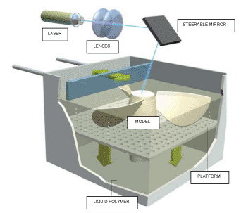
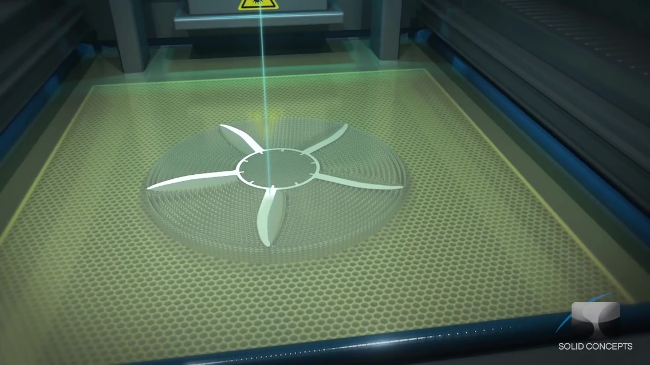
The Big Three (or four)
SLA – StereoLithography Apparatus
  Laser hardens a thin layer of photocurable polymer
  Examples dating back to 1984
  Layers 0.06mm (0.0025in)
  Minimum feature size
    0.25mm(0.01in)
Watch Video Here
www.lasersintering.com

Slide 5
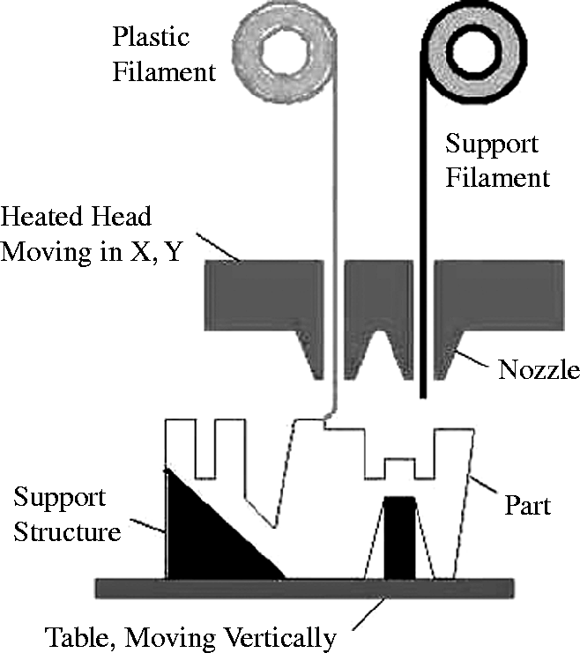
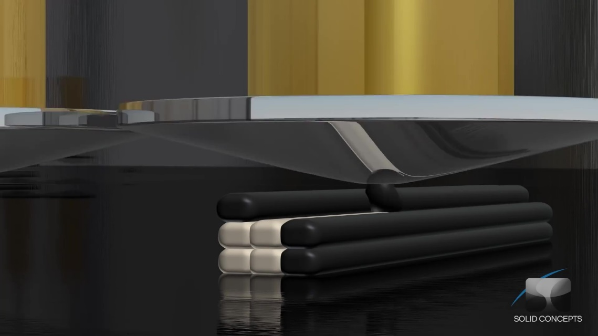
The Big Three (or four)
FDM – Fused Deposition Modeling
  Thin stream of plastic is extruded onto a platter
  Layers are typically thicker 0.254 mm (0.010 in)
  Parts are durable
  Minimum feature size
    1mm(0.025in)
Watch Video Here
www.emeraldinsight.com

Slide 6
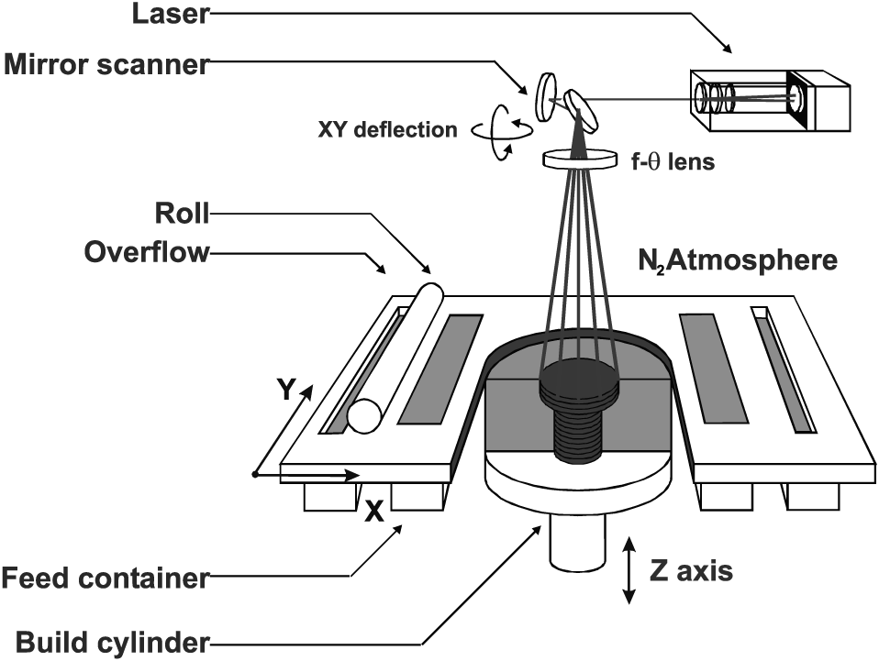
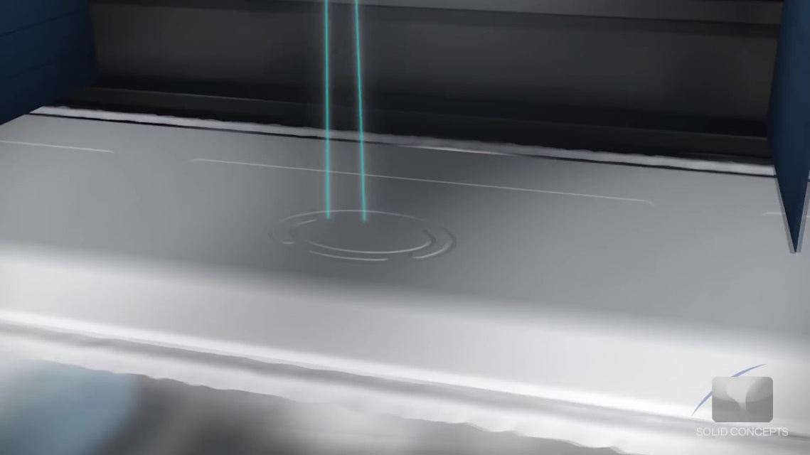
The Big Three (or four)
SLS/SHS – Selective Laser/Heat Sintering
  Fine powder is fused with laser or direct heat
  Wide range of materials - Nylon, Glass, Ceramic, Steel
  Layers 0.1mm (0.004in)
  Minimum feature size
    0.76mm(0.03in)
Watch Video Here
www.emeraldinsight.com

Slide 7
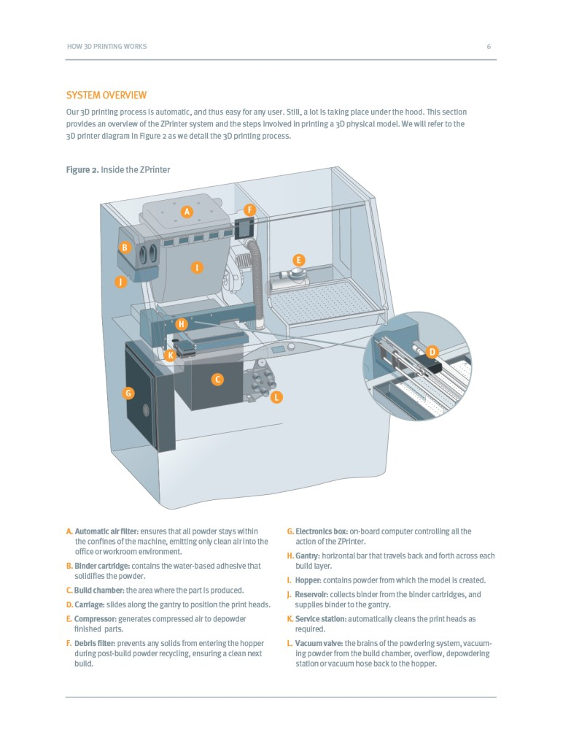
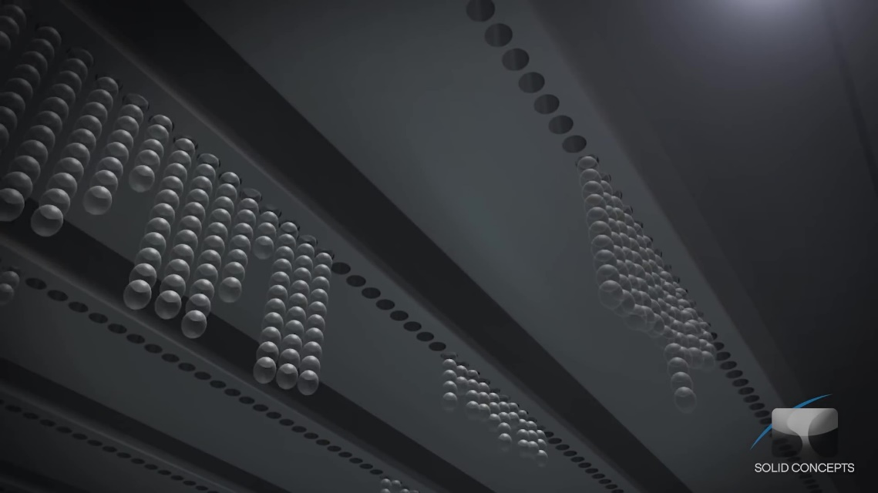
The Big Three (or four)
PolyJet
  Fine powder infused w/ binders
  Starch
  Can print in full color
  Layers 0.015mm
  Minimum feature size - 0.8mm
Watch Video Here
www.directindustry.com

Slide 8
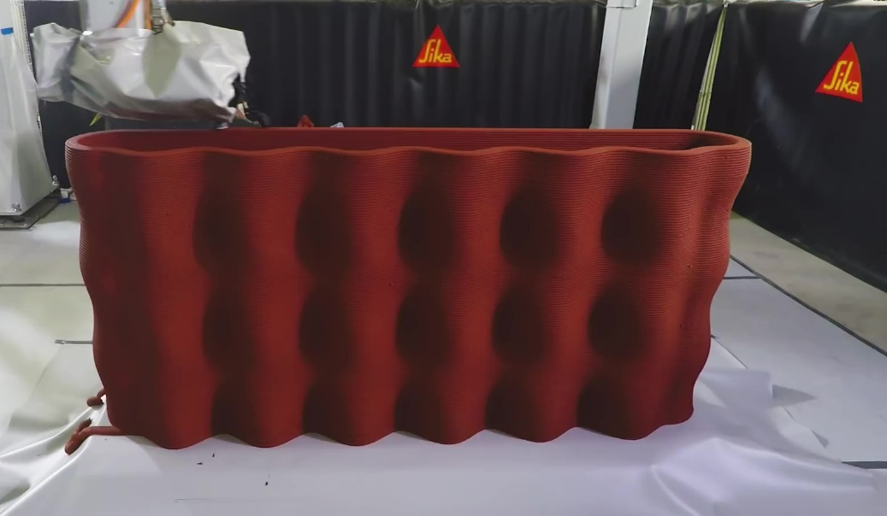
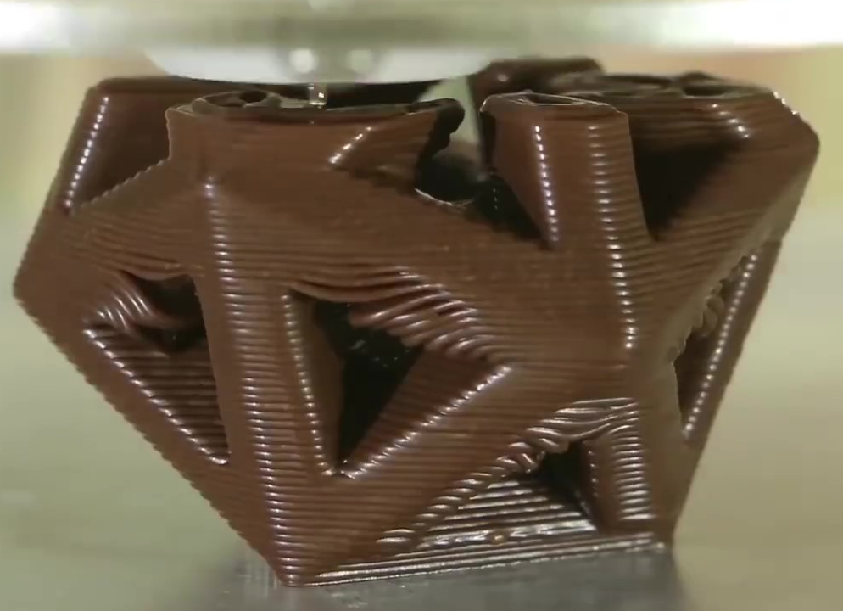
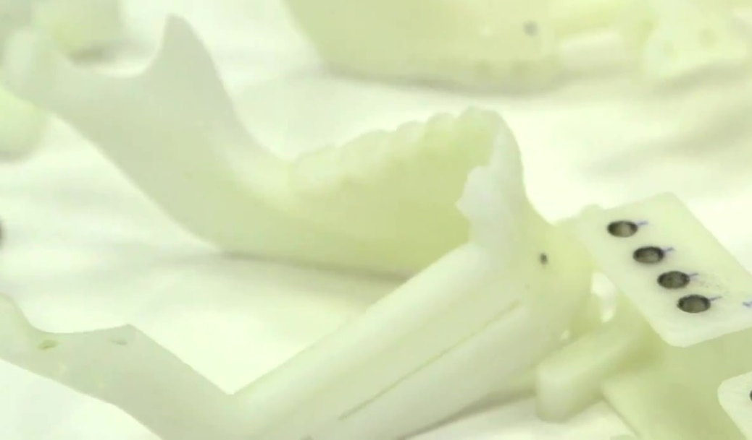
CONCRETE
CHOCOLATE
BONE

